Slide 1
Genetic characterization of hatchery-produced Ostrea lurida in Puget Sound, WA
Laura Spencer¹ • Brent Vadopalas¹ • Crystal Simchick² • Ryan Crim³ • Rick Goetz² • Steven Roberts¹
University of Washington, Seattle
NOAA
Puget Sound Restoration Fund
Aquaculture America, February 2018

Slide 2
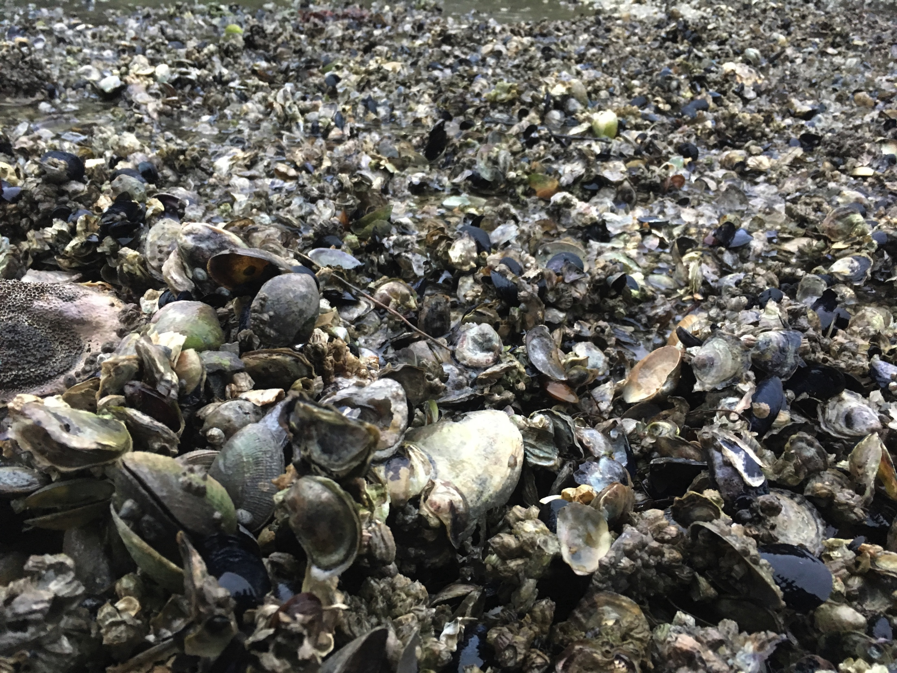
Today’s talk
Olympia oyster history & restoration efforts
Goals in breeding for restoration
Hatchery methods & genetic diversity
Take-aways

Slide 3
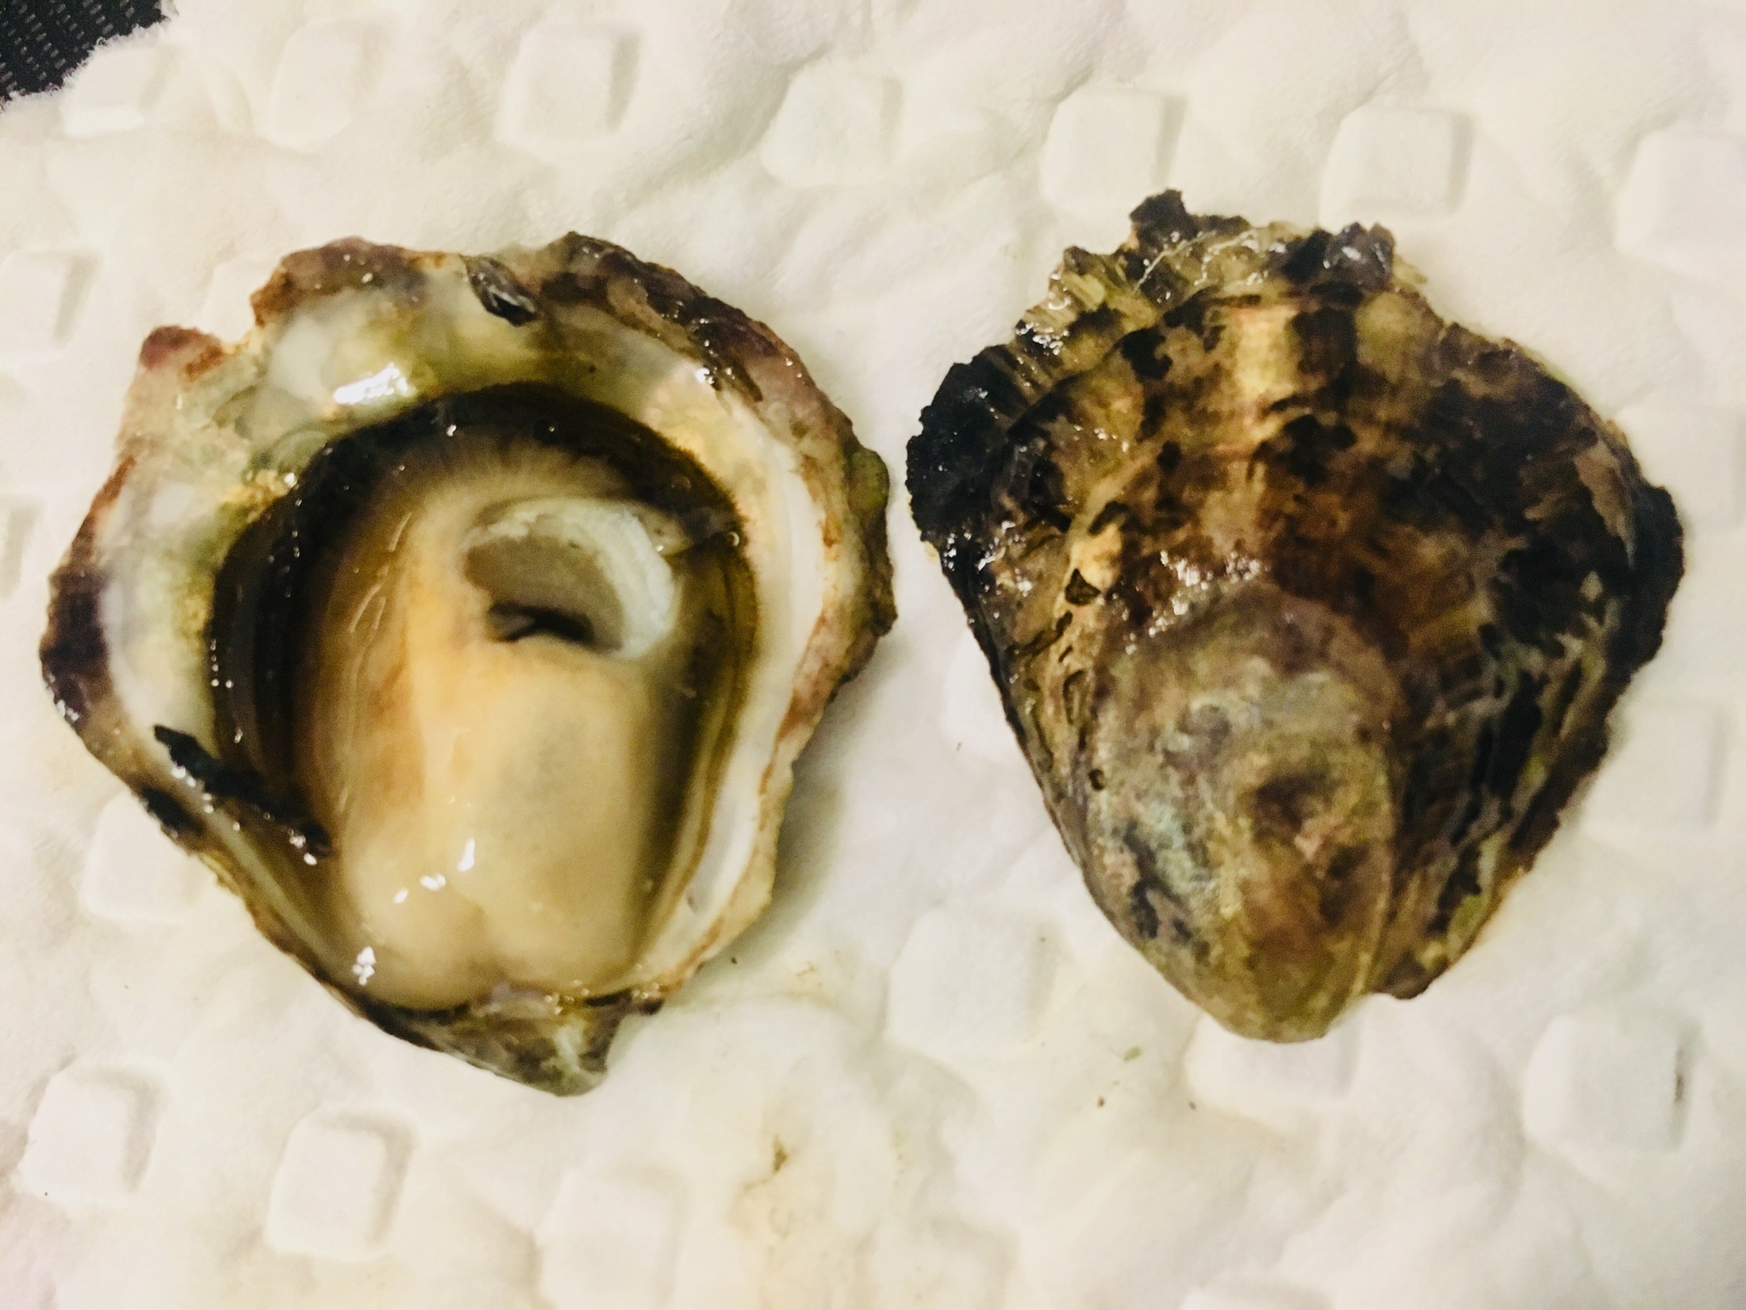
Ostrea lurida (Carpenter, 1864)
Notes:
On the screen is the Olympia oyster, these guys are an ostrea species …
Related to other flat oyster, such as European Flat Oyster, Ostrea edulis
Ostrea chilensis – Chilean oyster
Ostrea angasi – Australian flat oyster

Slide 4
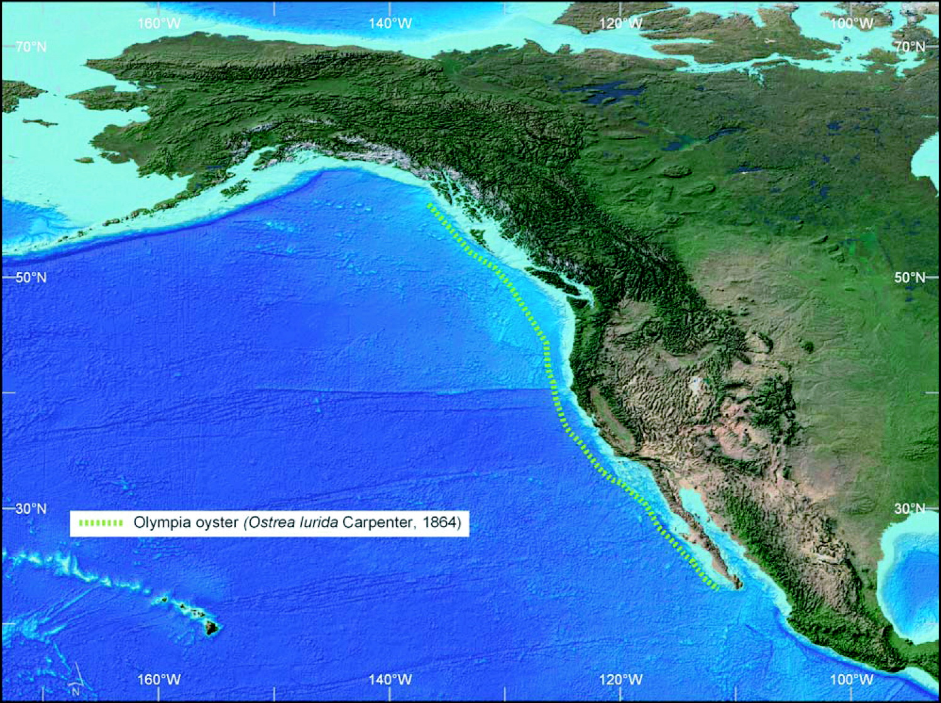
McGraw, 2009
Notes:
Ostrea lurida is the only oyster native to the Pacific Coast of North America.
Historic distribution spanned from BC down to Baja California

Slide 5
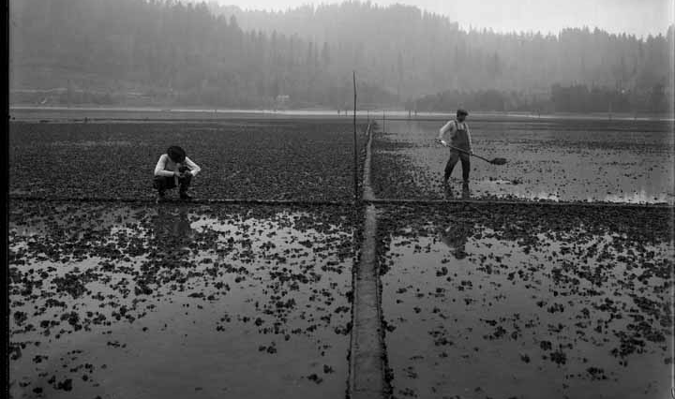
September, 1910, Brenner Oyster Company in Totten Inlet
– Washington State Historic Society
Notes:
Once abundant, supported commercial industry from mid 1800’s to early 1900’s
It also is believe to have been a vital food source for ancient indigenous populations, because shell piles – called middens – have been unearthed during excavations.

Slide 6
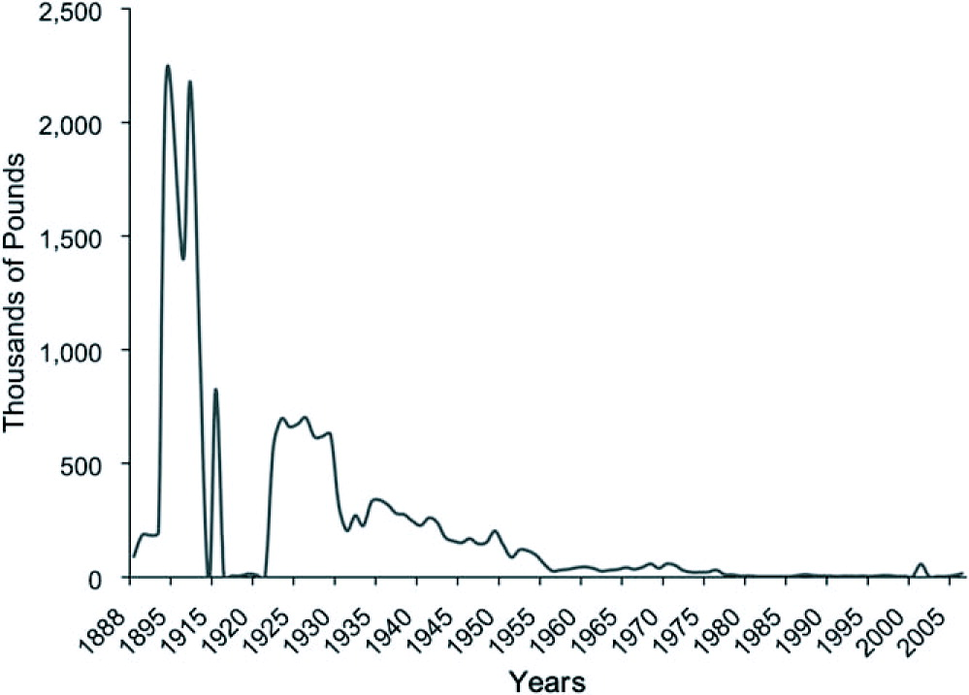
O. Lurida landings, all states (NOAA Fisheries Statistics)
McGraw, 2009
Notes:
Populations were overharvested beginning in the Gold Rush era …
Fig. caption: Olympia oyster (Ostrea lurida Carpenter 1864) landings (all states) from 1888 to 2006. (Data from NOAA Fisheries Statistics).

Slide 7
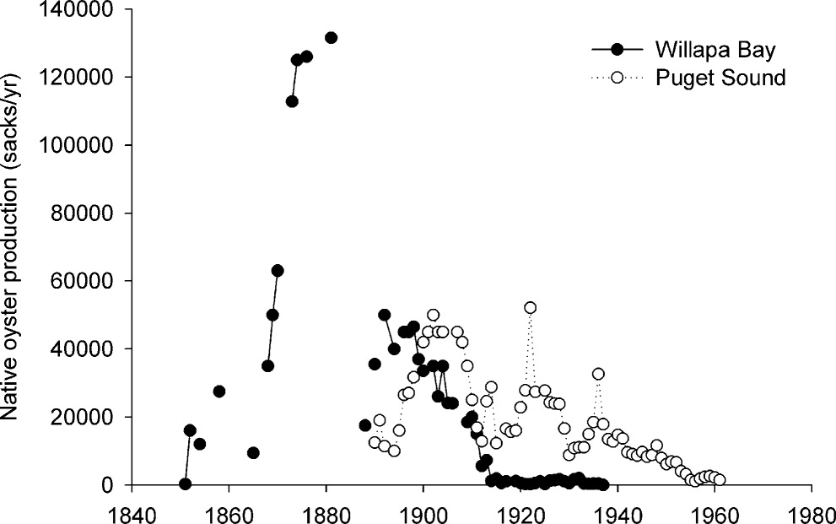
O. Lurida landings, Washington State
White, Ruesink & Trimble, 2009
Notes:
Overharvest was one culprit, but water pollution and the introduction of the Pacific oyster in the 1920’s are also considered contributing factors
dense Olympia oyster beds have dwindled to 5% of historic abundance (WDFW, 2013)
Figure 1. Ostrea lurida harvest in Willapa Bay and Puget Sound. Data are from Washington Marine Fish and Shellfish Landings—Statistical Reports. A sack of oysters contained about 4,000 individuals.

Slide 8
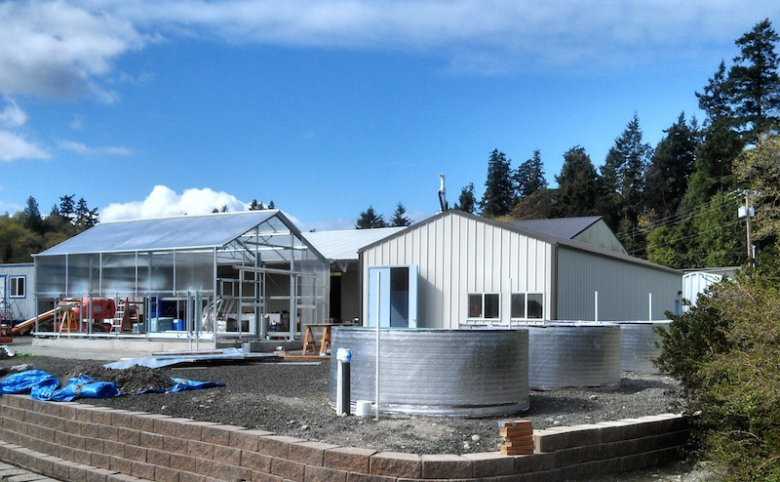
Kenneth K. Chew Shellfish Restoration Hatchery
Peabody & Davis, Puget Sound Restoration Fund, 2015
Notes:
Considerable restoration efforts to restore the Olympia oyster.
Unique b/c they not only are enhancing beaches by laying down shell hash or cultch for settlement habitat, but
Also – they are producing them, and supplementing wild populations with hatchery produced seed. Olys. They have been breeding Olys and outplanting seeded cultch or singles since ~2010.

Slide 9
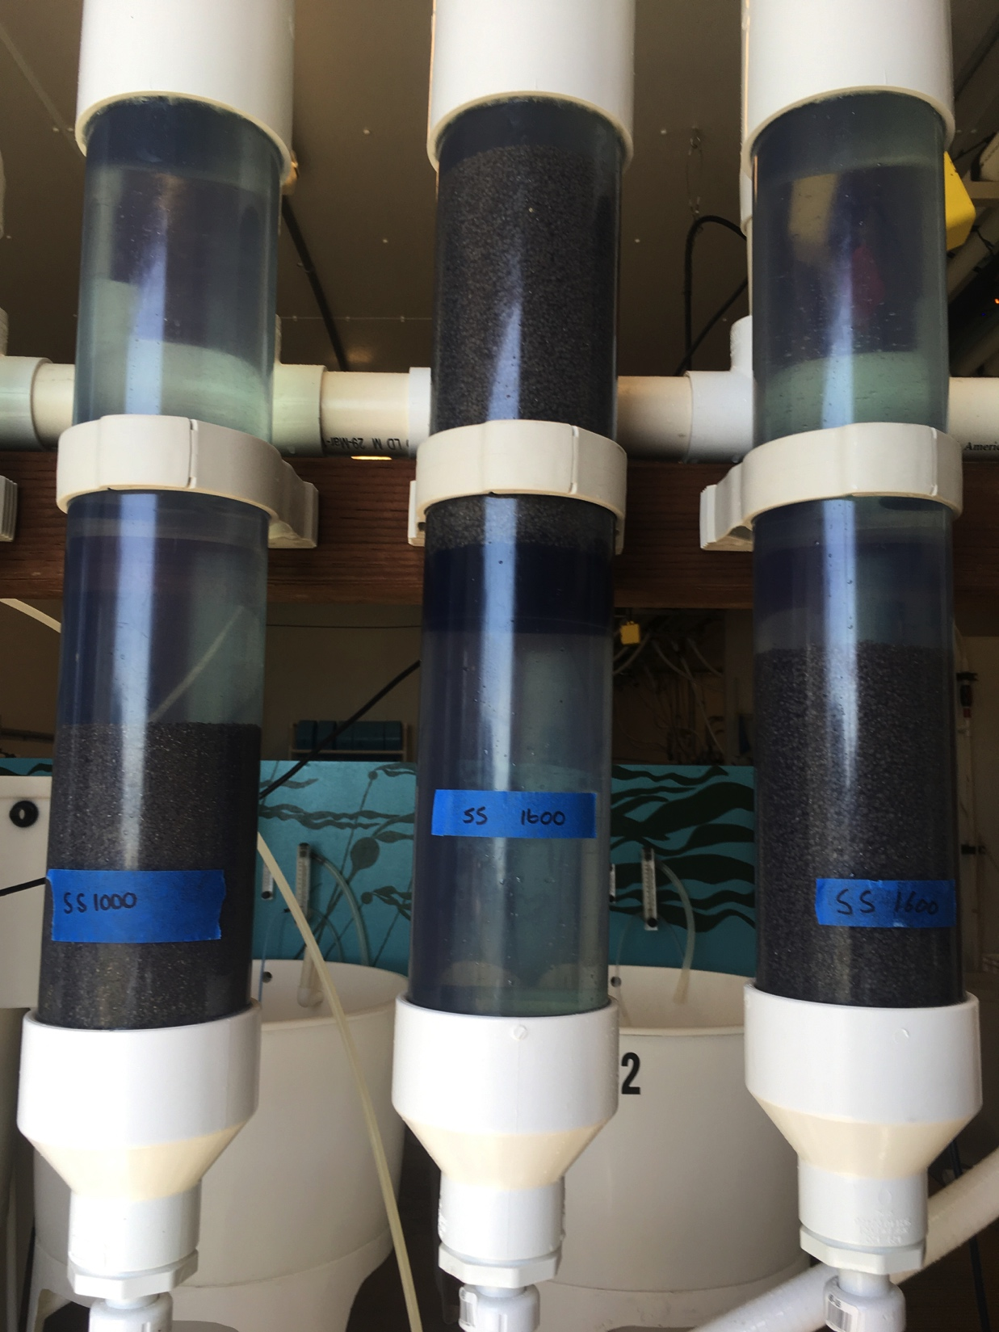
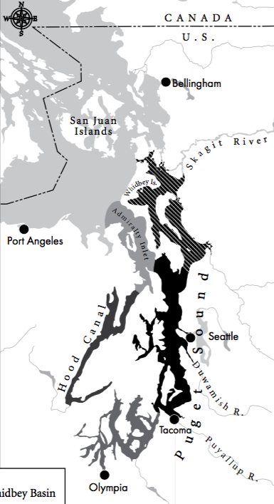
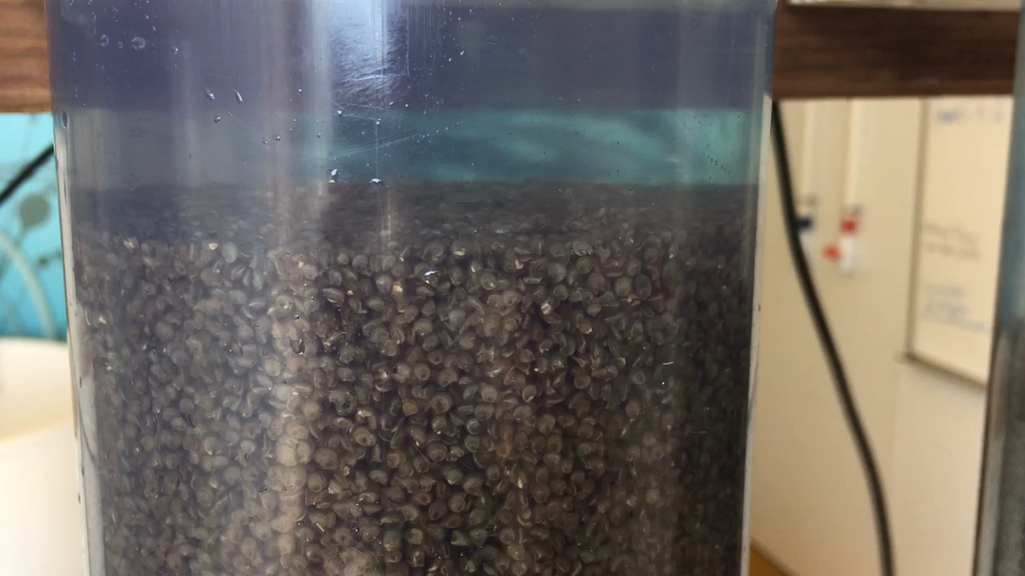
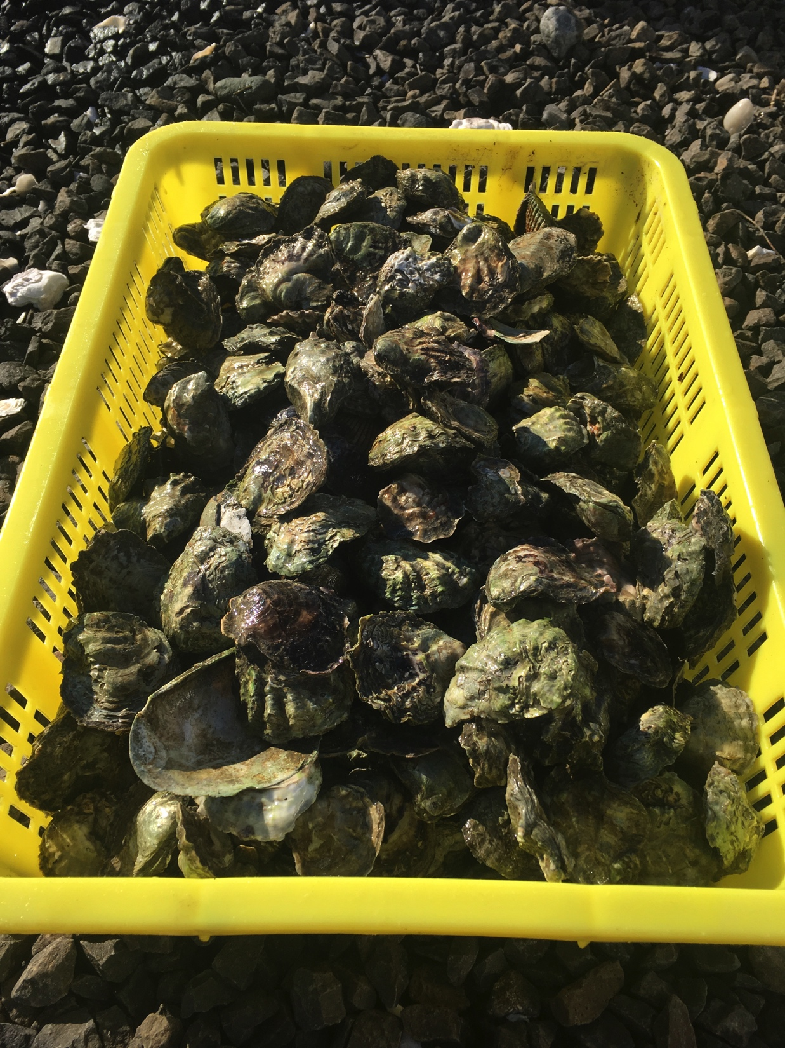
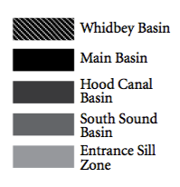
GOAL: DO NO HARM
Notes:
In the 8 years since beginning to culture and distribute Olympia oysters for restoration in Puget Sound, they have grown considerably from a very small facility to new hatchery, and become increasingly more successful. They have developed and refined practices specific to this species
2017 produced ~4.8 million Olympia oyster seed
Since the restoration hatchery opened, one of their primary goals – which differs from commercial breeding programs – is to produce genetically diverse seed.
Genetic diversity is an important consideration in supplementing wild populations. Goals are to avoid:
Hatchery selection: traits that are beneficial in the hatchery system amplified, but detrimental in natural system
Mixing genetically distinct sub-populations, locally adapted
Inbreeding, or only producing a few families
So, importantly: breed oysters within their subpopulations, and maintain genetic diversity within each subpopulation.

Slide 10
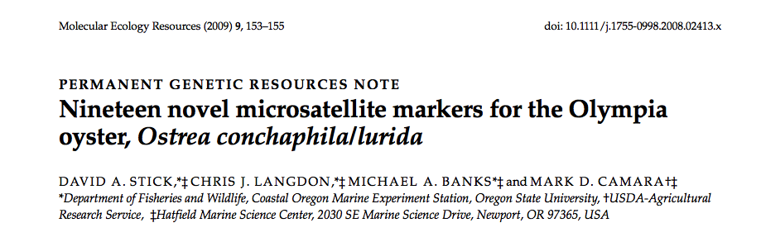
Are hatchery produced F1 genetically indiscriminate from wild F0?
Notes:
To measure how effective the breeding methods are at maintaining diversity, we can use microsatellite markers.
Microsatellites are useful for genotyping. They are basically very short DNA sequences that are repeated, and the number of times they repeat are genetically passed between generations. Microsatellite are a relatively cheap way to do genetic testing. They are often used in paternity tests, and forensic.
In 2009 OSU developed 19 microsatellite markers, for Olympia oysters – and since 2010 we’ve done a series of sampling to compare hatchery produced oysters, to the wild oysters. Question we’re asking is …
This genetic testing project has actually informed Olympia oyster breeding methods.
I’d like to show you a couple different breeding methods, and have you predict which one produces oysters with greater genetic diversity.
BEFORE I go on … a couple things to note about the Olympia oyster life cycle:
Females are brooders – so they do not BROADCAST their eggs, but are internally fertilized, and actually brood their larvae for ~2 weeks, then release veliger larvae with fully formed shells.
They are equential hermaphrodites - alternate between male and female 1x or 2x within a spawning season
B/c of these two things & we don’t want to kill oysters – NO STRIP SPAWING
I’m going to show you 2 different breeding methods that we have used, and then I’ll take a poll to see which one you think produces more diverse oysters.

Slide 11
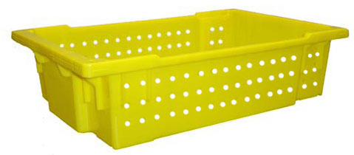
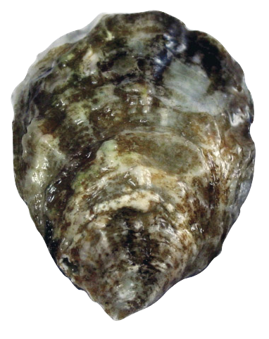
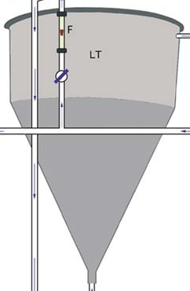
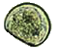
Breeding method A
N=~1,500 broodstock
Mass volitional spawn, no larvae separated
Notes:
Breeding method A: mass volitional spawning
All broodstock go into one large tank, the oysters induced to spawn over ~1-2 months, and hatchery staff collects larvae.
No control over the number of crosses, and therefore larvae are not grown in separate families

Slide 12
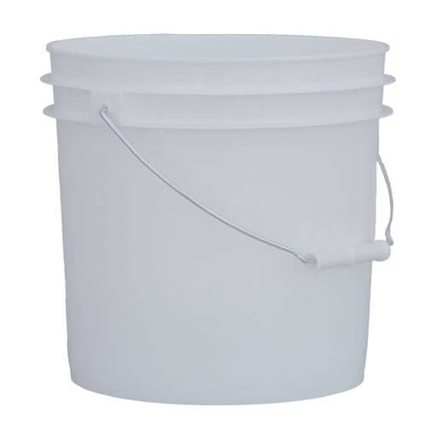
Breeding method B
n=~20 brood-stock per family
…
Family 1
Family 2
Family 3
Family 10
…
Separated broodstock & larvae
Notes:
Breeding method B: spawns in 10 families, with 20-25 oysters per family.
Larvae are also reared separately, by family.
How many of you think that method B produces seed with higher genetic diversity? More families?

Slide 13
Microsatellites informed breeding methods
2010 Seed vs. Wild
P-value across all loci
(Fisher's method)
------------- --------
Olur10 0.12648
Olur11 0.30144
Olur12 0.05675
Olur13 0.52318
Olur15 0.41777
Olur17 0.00216
Olur18 0.00256
All: Chi2= 39.524 (df= 14) P-value= 0.000302562
Family 1
Family 2
Family 3
2010-2014 Separated broodstock & larvae
Notes:
This bucket method was actually used first few years of the program, 2010-2014, and microsatellite testing showed that it was not producing offspring as diverse as wild.

Slide 14
Microsatellites informed breeding methods
2016 Seed vs. Wild
P-value across all loci
(Fisher's method)
-------------------------------------Locus P-Value
------------- --------
Olur10 0.32784
Olur11 0.54191
Olur12 0.67662
Olur13 0.08560
Olur15 0.06505
Olur19 0.01146
All: Chi2= 18.39076 (df= 12) P-value= 0.104331
Mass spawn, collected for 4+ weeks,
2014-today separated larvae based on capacity

Slide 15
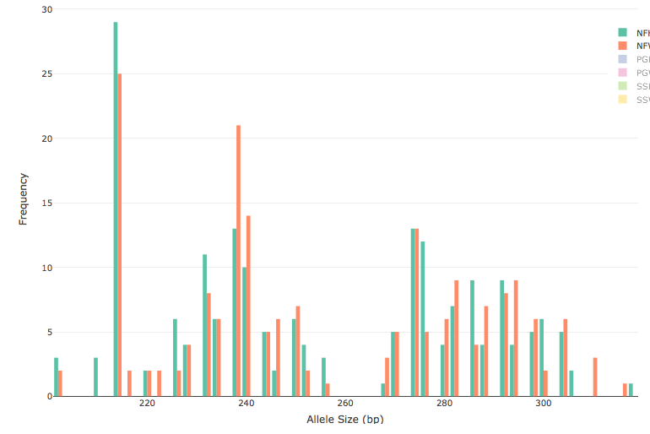
2016 Hatchery vs. Wild
Orange = Wild
Green = Hatchery F1
Locus “Olur10”
Notes:
For those of you familiar with microsatellite testing, here’s the frequency distribution of alleles for one of the microsatellite loci; what we’re looking for is a similar distribution for both hatchery & wild, with equal variance.

Slide 16
Take-aways, Limitations
Take-Aways
Genetic testing informed breeding methods
Better method: Mass volitional spawn
Added benefit: less manpower, resources
Important to use many broodstock (no-kill required)
Limitations of Microsatellite Markers
Not directly assessing hatchery selection
More robust testing soon! (SNP testing)

Slide 17
BONEYARD SLIDES

Slide 18
Microsatellites informed breeding methods
2011 Seed vs. Wild
P-value across all loci
(Fisher's method)
-------------------------------------Locus P-Value
------------- --------
Olur10 0.00663
Olur11 0.22946
Olur12 0.01095
Olur13 0.01624
Olur15 0.00054
Olur17 0.00011
Olur18 0.09468
All: Chi2= 68.2382 (df= 14) P-value= 4.01679e-09
Day 1
Day 2
Day 3
2011 Mass spawn, separated larvae by daily collections

Slide 19
Microsatellites informed breeding methods
2014 Seed vs. Wild
P-value across all loci
(Fisher's method)
-------------------------------------Locus P-Value
------------- --------
Olur10 0.00589
Olur11 0.08276
Olur12 0.08509
Olur13 0.33546
Olur15 0.40096
Olur17 0.01866
Olur18 0.11308
All: Chi2= 36.5151 (df= 14), P-value= 0.000873228
Week 1
Week 2
Mass spawn, collected for X weeks,
2014 separated larvae based on capacity

Slide 20
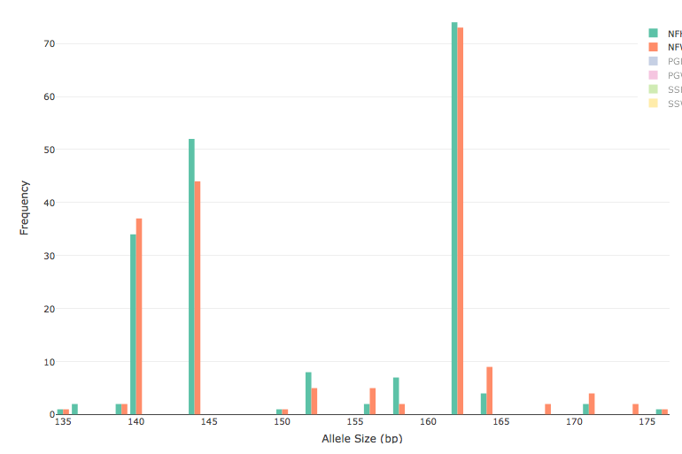
2016 Hatchery vs. Wild
Orange = Wild
Green = Hatchery F1
Locus “Olur11”

Slide 21
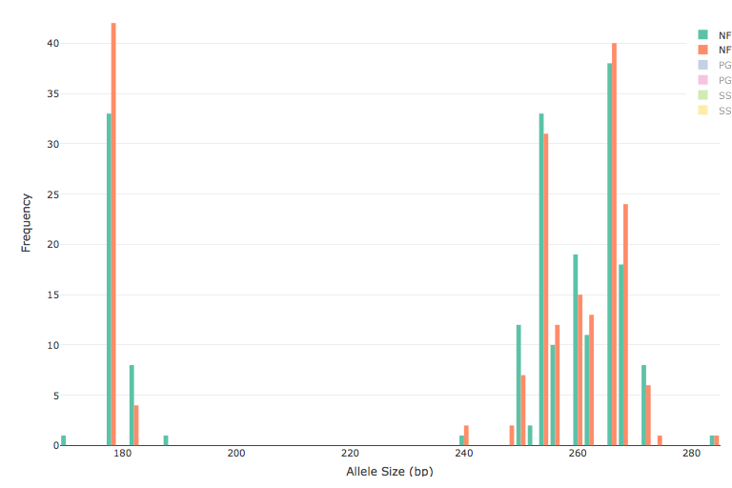
2016 Hatchery vs. Wild
Orange = Wild
Green = Hatchery F1
Locus “Olur12”

Slide 22
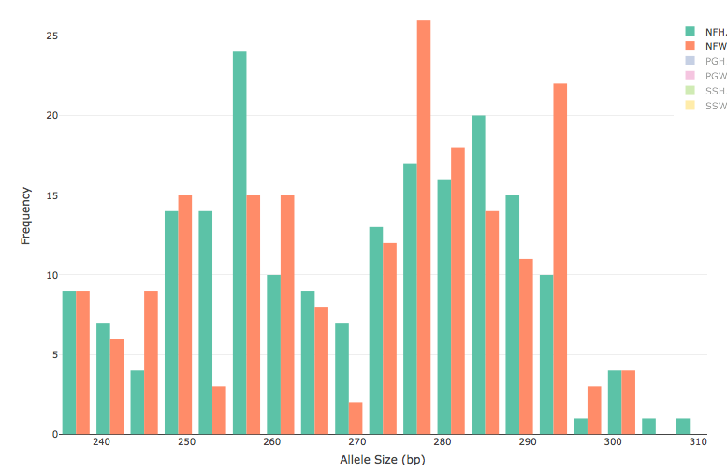
2016 Hatchery vs. Wild
Orange = Wild
Green = Hatchery F1
Locus “Olur13”

Slide 23
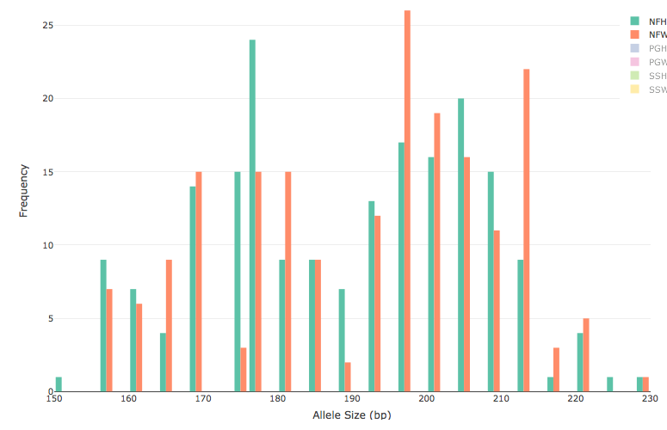
2016 Hatchery vs. Wild
Orange = Wild
Green = Hatchery F1
Locus “Olur15”

Slide 24
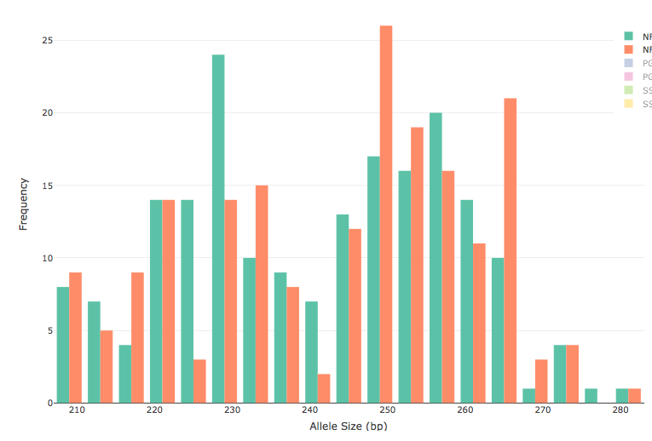
2016 Hatchery vs. Wild
Orange = Wild
Green = Hatchery F1
Locus “Olur19”

Slide 25
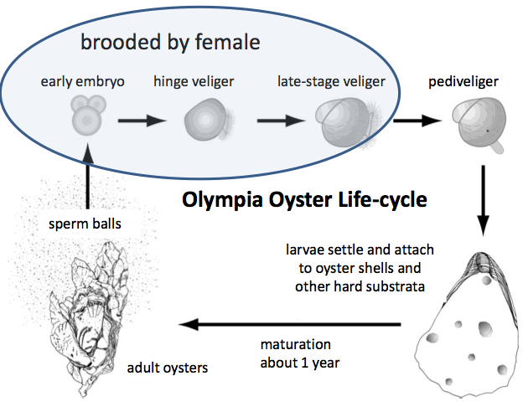
Larvae brooded to pediveliger stage
Notes:
Before I continue = quick lesson on the olympia oyster life cycle
Females are brooders. Females do not broadcast spawn their eggs, but males do. Males release sperm, females filter them in and fertilize their eggs, then the embryos develop, larvae are maintained by the female in their mantle cavity until they have a fully formed shell, then they are released into the water.

